Slide 1
Team Foundation Overview

Slide 2

Agenda
Software Configuration Management
Team Foundation Capabilities
Team Foundation Architecture
Notes:
We’ll start off by talking briefly about software configuration management before delving into the new toolset.

Slide 3
What is SCM?
The set of strategies employed for managing the integrity and evolution of a base of source code.
Encompassing:
Source Code Control
Work Item Tracking
Build Management
Release Management
Notes:
Introducing the core concepts of SCM

Slide 4









Releases
Lists
(Bugs, Requirements, etc)
Management
Questions
Team
Communication
Process
Guidance
Source Code
Assets
Notes:
These are the central issues faced by all development teams.
Lists – Bugs, requirement etc typically managed by lots of different systems in e.g. Excel, custom bug tracking systems etc
Process Guidance – People using lots of different processes and methodologies whether formal or home grown. We need tools which assist us in following process.
Management Questions – What state is the project in now ? How much code churn do we have in our nightly builds ? etc – Usually very difficult to answer
Source Code Assets – Often the most important thing to manage; currently a bit painful with Visual SourceSafe
All of these require the team to communicate well in order to finally build the product and release it
Currently managing all of this is somewhat painful to say the least due largely to a lack of good tool integration.
The testing tools don’t integrate with the bug tracking tools. The bug tracking tools don’t integrate with the source code control system
Organizations create rules like: “You must include the bug ID in your checkin comment” and then developers ignore or forget them.
Source code changes are rarely confined to a single file. How do you track the changes across files? Need to treat them as an entity (Source Depot’s change lists)
Where you have multiple product branches in your source control repository, how do you know which changes have already been migrated and how do you ensure that an entire change is migrated?
When doing automated builds, how do you version the source and the tools for your builds to reduce the burden of creating and maintaining a build process. You also want to know which bugs/features are addressed by which builds.
Some products (i.e. Rational) have attempted a level of integration with kind of band-aided solutions. Microsoft felt that it was time for something completely new to give users the best possible experience.

Slide 5
Developer Needs?
Standard version control
Historical traces from code to work item
  What was the requirement?
  What bug was being fixed?
Parallel development
Notes:
So different team members all have their own requirements from an SCM strategy.
Developers require all these features without ever having to leave Visual Studio !
The SCM process must be injected into their daily activities in a very non-intrusive way

Slide 6
Tester Needs?
Version control for test artifacts
Notification of available bug fixes
Release notes for individual builds
Notes:
How many times have you had to manually compile lists of which bugs/issues have been fixed by which build?
This is crying out for automation and integration.

Slide 7





Visual Studio Team Foundation
Integrated Platform for Collaborating on Software Development Projects.
Work Item Tracking
Source Code Control
Reporting
Build Automation
Team Communications
Notes:
Provides world class tools in each of these areas and more importantly tightly integrates them with each other as well as with Visual Studio
Team Foundation is designed to support iterative development.
-All of the items are work items and all of the tools are different views onto the work items.
-All work items are in a single Team Foundation database.
-You can sort, schedule, query, triage, and manage all work items together.

Slide 8
What is VS Team Foundation?
Work Item Tracking
Source Code Control
Reporting
Build Automation
Team Communications
Notes:
So lets now talk about work item tracking which is something all development teams already do in one form or another.

Slide 9





Work Item Tracking
Concepts
Work Item
  Bug, task, requirement, etc
Artefacts
  Work Items
  Source files
  Changesets
  Builds
Linking
  Work items can be linked to other artefacts
Notes:
A work item is a new term which really generalises or abstracts the concept of a bug. It is used to define any unit of information which has e.g. workflow, state transitions and can be assigned etc. For example, a bug, task, requirement, scenario etc
Artefacts is a general term used to describe software configuration items.
Changesets are the product of a check-in operation and are a new concept
They describe a group of associated file modifications allowing for simplified administration and workflow accounting
They are given a unique identifier for tracking
The ability to link work items to other artefacts is key to an effective SCM strategy.
Linking work items to source files and changesets allows you to track e.g. which changes dealt with a particular requirement or which files were changed in order to correct a particular bug.
It is also important to be able to easily track which work items are in which builds.

Slide 10
Work Item Tracking
Custom Work Item Types
Every organization works differently
  You must be able to customize
Each type consist of:
  Fields, form, rules, states
Build on standard methodologies
  Visual Studio ships with MSF
Notes:
As with all the Team System tools, extensibility is a major theme.
In WIT, this is enabled through the ability to fully customise all aspects of work items and work item types.
This include the actual fields stored with them, how they appear in the UI and the rules and workflow associated with them.
These are then surfaced in your software development process through the methodology templates just like the supplied work items and types.

Slide 11
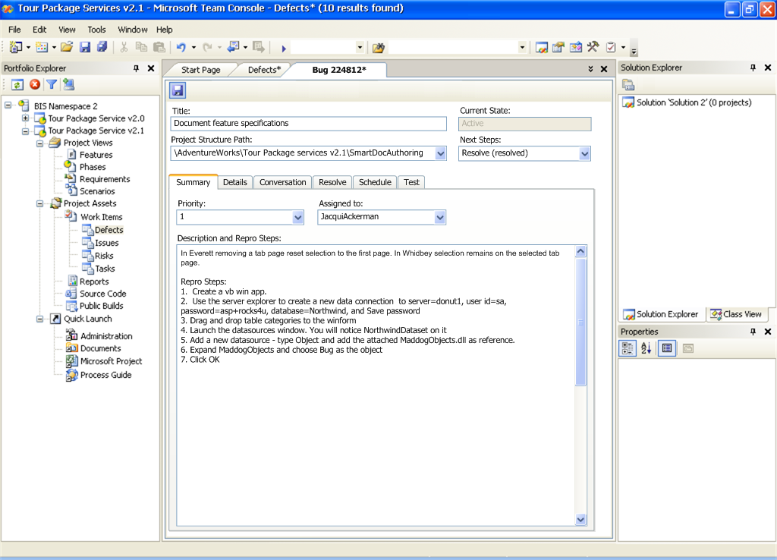
Visual Studio Work Item View
Team Project
Explorer
Shared project context links multiple VS solutions
Work Item
Access
Valid work item types defined per portfolio project
Work Item Form
Customized per work item type
Notes:
So here’s a quick look at work item tracking inside of Visual Studio.
Work item tracking is embedded in VS. There is a team project explorer. Addresses key issue of every project has own notion of explorer. Shows all artifacts related to the project. Is extensible, so can have plugged in node for 3rd party or partner. It is how people navigate to get to a WI.
The actual layout to all these fields, windows is all customizable. You can add or remove tabs not relevant to your company. VS has a query builder (e.g., I want all WI that are in an active state). There is a triage view, where you have a results list of various forms.
Using the new Portfolio Explorer, you can write your own queries using the query builder and even customise the columns returned in the results view.
You can open individual work items as documents within VS and there is also a triage view with the list of results at the top and the work item details at the bottom.
Microsoft have been using ProductStudio for WIT for years and this is basically an enhanced Product Studio fully integrated into Visual Studio
You can also update/resolve work items as well as create brand new ones all from within Visual Studio
So work items can be modified and reassigned by anyone with appropriate permissions. They are tracked in reports, scheduled using MsProject and can be managed in Excel.
Teams can define their own work item types with their own fields, state transitions and workflow rules.
Developers use work items to prioritze their work and notify testers and other devs when a fix has been done for example.
Architects, designers and other team members can create and assign work items to record issues and track progress toward the completion of their goals.

Slide 12
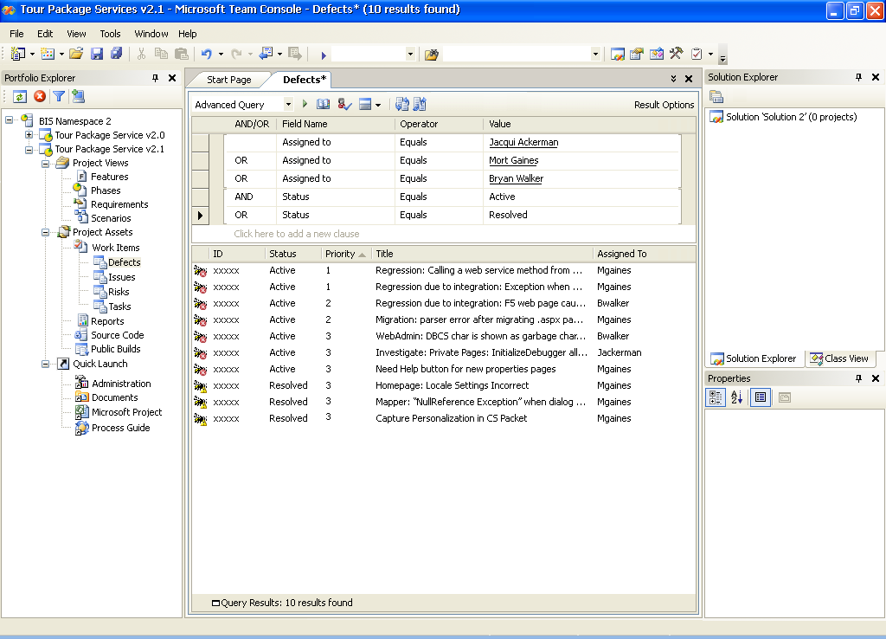
Visual Studio Query View
Query Builder
Flexibly define queries, query across multiple types
Results List
Sort by Columns
Notes:
There is not currently a web interface to the WIT in V1, we will build that in V2.
Talk about Team Foundation Client: E.g., User Acceptance Testers would use the Team Foundation Client. Does not have all the debuggers, compilers, etc.

Slide 13
What is VS Team Foundation?
Work Item Tracking
Source Code Control
Reporting
Build Automation
Team Communications
Notes:
Let’s turn our attention now to the subject of Source Code Control.

Slide 14





Team Foundation
Source Code Control
3-tier, web service architecture
Built on SQL Server for robust, transaction-based version control
Integration with other VSTS tools for automated workflow management
Implementation of advanced SCM concepts
Migrate from
  VSS, ClearCase, Source Depot
Notes:
Team Foundation has a completely new Enterprise Level Source Code Control system
It is in no way a port of either VSS or Source Depot but has been developed from scratch.
The goals of Hatteras are as described earlier
Ease-of-use
Leverage VSS
Low administration – no release manager required
Tight Tool Integration
Scalability
Support small to Microsoft sized teams
It provides a very process-oriented approach to SCM.

Slide 15
SourceSafe vs Team Foundation
 | Visual SourceSafe 2005 | Visual Studio 2005 Team Foundation
Description | Version Control | Integrated Software LifeCycle Suite
Team Size | Individuals and Small Teams | Scalable
Storage | File System | SQL Server 2005
Security | Application specific | Windows Integrated
Remote Access | New Web Service for VS Integration | Optimized Web Service
Notes:
VS Team Foundation is built using a 3-tier architecture based on SOAP and ASP.NET Web Services. It uses SQL Server 2005 at the backend so is built using the same architecture that Microsoft recommends the rest of us use. It really is about as robust, secure and scalable as it gets.
All SCC activity happens via Web Service protocols so MS really are eating their own dog food here.

Slide 16
Source Code Control
Features
Complete version control feature set
  Everything from VSS plus….
Innovative new SCC features
  Integrated checkin
  Parallel development
  Atomic checkins
  Remote development
Strong integration with other VS Team System tools
Notes:
As we said earlier, a lot of the familiar ‘concepts’ from VSS have been carried forward and enhanced.
Unlike VSS, Hatteras tracks more than just file changes. Specifically, it tracks additions, deletions and renames automatically. How many of us have forgotten to add new files to VSS and thereby broken the build! This scenario will no longer be possible.
We also have atomic checkins thanks to using SQL Server (Yukon) as the repository. If a single file fails to checkin then the whole changeset will be rolled back and there is never a danger of another developer getting a partial set of files.
As with all the Team System tools, SCC is tightly integrated with Visual Studio and Team Foundation giving us our software configuration management solution.
So now let’s drill down a bit into some of these new features.

Slide 17
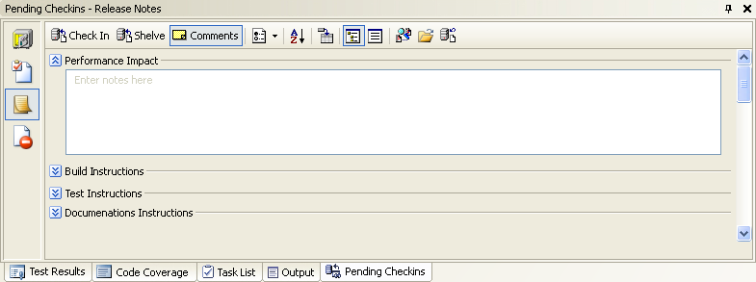
Source Code Control
Integrated Checkin Experience
Combines changes, comments, work items, policy, e-mail
Captures valuable data relationships
Customizable for your process
Notes:
The Pending Check-Ins window shown on this slide (which already exists in VS 2003) has been greatly enhanced in VS 2005 to allow more information to be collected as part of the check-in process.
Imagine a typical check-in process today
Firstly, you must remember to run static analysis and unit test your work
Then you must get it reviewed/approved by a buddy
Then you would need to resolve all the ‘issues’ or work items relating to the changes you have made
You may then have to compile changeset documentation
Finally, you would need to notify other team members probably via email and templates
Typically, the above process might involve as many as 4 or 5 different applications just to check in some code which is all a bit painful
Now, with VSTS you never even have to leave Visual Studio.
The pending check-ins window constantly tracks all changes, additions, deletions and renames so no more forgetting to check-in new files !!
Checking in can also automatically change the state of the work items and assign them to the testers as part of your process workflow.
You can also use the ‘diff’ tool directly from this window for e.g. code reviewing. You can even plug in your own diff tool if you prefer.
-----------------------------------------------------------------
We will see all of this in action in a moment.

Slide 18
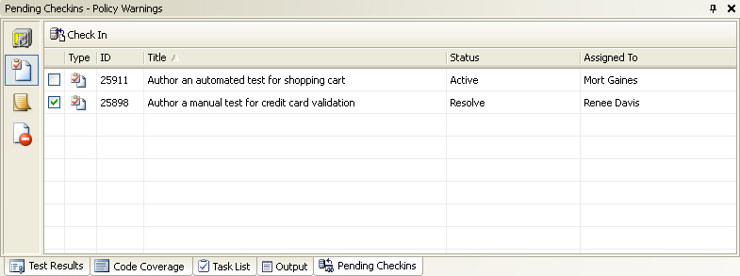
Associate Work Items
User Simply checks associated work items
Notes:
Using the Pending Check-Ins window you can use the new channel bar on the left to view your assigned work items and simply tick the ones associated with your changes.

Slide 19
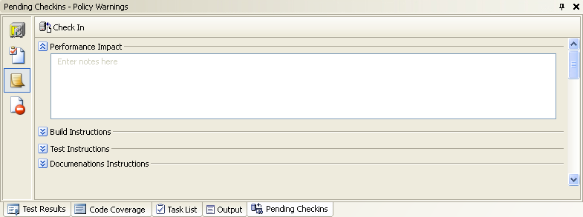
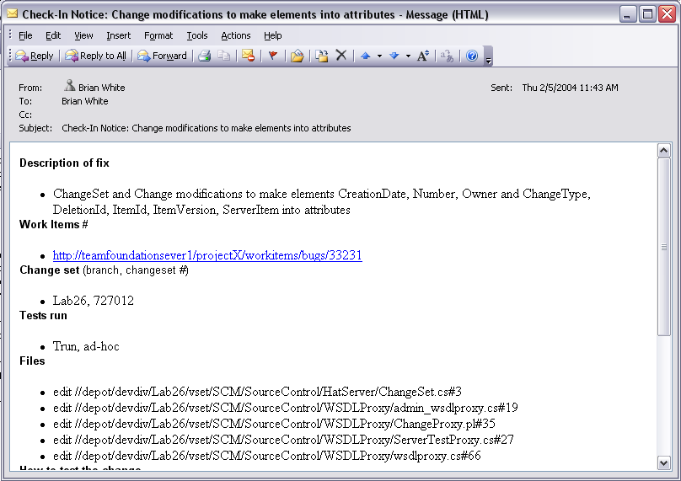
Checkin Notes and Notification
Entered at Checkin Time
Defined per Portfolio Project
Included in Checkin E-mail
Used in Build documentation as well
Notes:
There is a new check-in notes view where you can communicate other relevant information to your team. This is even customizable to include whatever fields/information your team requires as part of the ‘process’ setup. All the data you enter here is automatically persisted in the repository and included in the email which VSTS sends on your behalf.

Slide 20
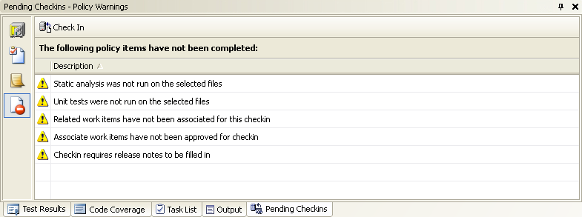
Validate Policy Detail
SCC Policy Engine
Policy Definitions
.NET Assemblies
Return Pass or Fail and message
Customer Extensible
User Over-ridable
WI Association
Release Notes
Unit Testing
Static Analysis
Custom Policy
Notes:
There is a new Policy Warnings view showing any policy violations. Policies are established as part of your process. For example, you may require that developers run static analysis prior to check-in and/or that all checkins are associated with one or more work items (these two policies actually ship oob with MSF 4.0 and enable great work item tracking features)
Policies can be fully customized (and allowed to be overridden – with PM getting notif’n email). New policies are simple to plug into the framework.

Slide 21
Source Code Control
Parallel Development
Multiple Releases
  Branching
  Merging
Multiple Checkouts
Shelving
  Interrupted workflow
  Transfer changes without checkin
  Checkpoint or share work in progress
Notes:
Effective branching and merging is essential to any SCM tool. Branching appears very similar to VSS and Source Depot in that a new copy of the files is created in the repository. There is more to it however, since a relationship is established and maintained between the original and the branch. All changes can therefore easily be tracked including which have been ‘merged’ between the two.
Hatteras contains new and powerful merging capabilities which supports not just changes but also additions, deletions, renames etc. You can run merge candidate queries to see what still requires merging and can even cherry-pick what gets merged when. E.g. show me everything in one branch which needs to be merged into the original. The query returns a list of changesets which need to be moved over. Remember a changeset is an atomic (transactional) package which makes change management a great deal easier.
The ability for developers to simultaneously checkout the same file(s) is now turned on by default. In VSS it was off by default and very few people were brave enough to turn it on. Now with the new merging capabilities, it is easy for one developer to check in their file and a subsequent developer to do the same resolving any minor conflicts where necessary before they turn into major conflicts.
Shelving is probably one of the most talked about and eagerly anticipated new features of source code control.
Interrupted workflow
Imagine you’re working on some new feature and an urgent bug fix requirement comes in.
Now you can shelve your changes, restore your workspace to the original (unmodified) files
You can then fix the bug and check it in before finally unshelving your original work which will also merge in the bug fix!
Also, imagine you need to transfer your work between your laptop and desktop or even transfer it to another developer. You can simply shelve it and then unshelve it on another machine.
Shelving is also great for backing up your work in progress.
Shelving takes care of creating private branches in the repository for you and then cleaning them up when you unshelve.

Slide 22
What is VS Team Foundation?
Work Item Tracking
Source Code Control
Reporting
Build Automation
Team Communications

Slide 23


Build Automation
Out-of-the-box daily build
Good build process is hard to achieve
  Many shops don’t even bother
Goal: make it trivial
  Builds are reproducible
  VS Projects are built directly
  Builds are scheduled or on-demand
  Build report is centrally published
Goal: tight integration with VS Team System tools

Slide 24
What is VS Team Foundation?
Work Item Tracking
Source Code Control
Reporting
Build Automation
Team Communications

Slide 25

Reporting
Provides system-wide data view
Ships with many beneficial reports
  You can customize or add more
Built on SQL Server Reporting Services
Notes:
Will provide a whole number of reports (about 50 of them). But is also flexible for building your own reports. All based on SQL Reporting engine.
Example Reports
Project Health Report
Code churn and bugs by developer
Getting this organized in one report given all the historical information is very valuable.

Slide 26
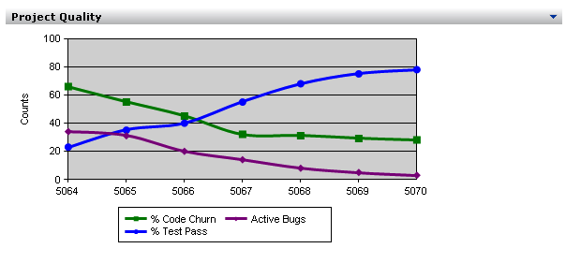
Reporting

Slide 27
What is VS Team Foundation?
Work Item Tracking
Source Code Control
Reporting
Build Automation
Team Communications

Slide 28

Project Site
Facilitates team communication
  Specs, discussions, announcements, lists
  Work items, reports, public builds
Lightweight access for casual stakeholders
Built on Windows Sharepoint Services
Notes:
We will create a WSS sharepoint site at time of project creation. Place for docs, specs are stored, access to all reports, (public builds). Based on WSS, not full sharepoint structure.

